Slide 1

“DetectorRS”
㈜롯데정보통신 프로젝트 교육생
지 명 화

Slide 2
목차
01 Introduction
02 Recursive Feature Pyramid
03 Switchable Atrous Convolution
04 Experiment

Slide 3
Introduction

Slide 4
01 Introduction
Object Detection - multi-stage
Multi-Scale Features - FPN, Atrous Spatial Pyramid Pooling
Recursive Convolutional Network - fusion modules, ASPP
Conditional Convolution - Switchable Atrous Convolution

Slide 5
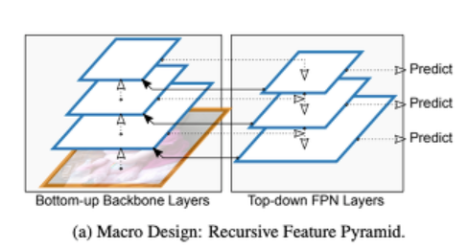
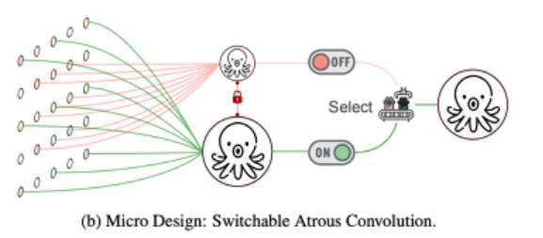
01 Introduction

Slide 6
Recursive Feature Pyramid

Slide 7
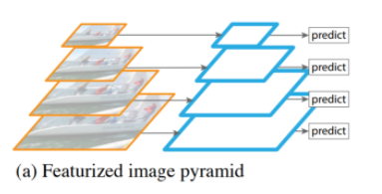
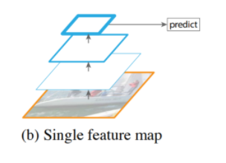
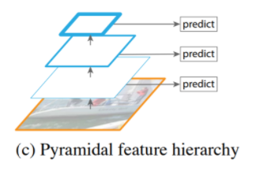
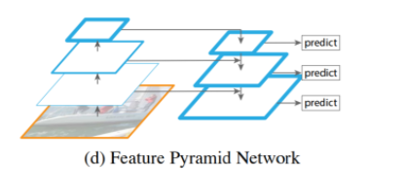
02 Recursive Feature Pyramid
FPN가 등장하기 전까지…

Slide 8
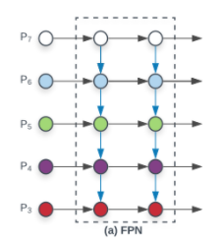
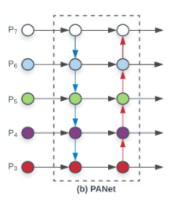
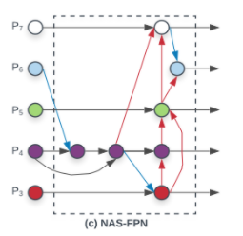
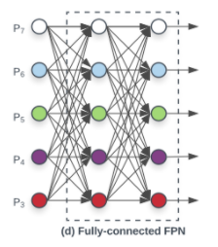
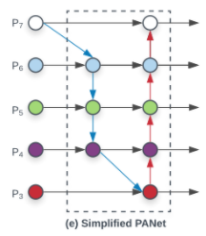
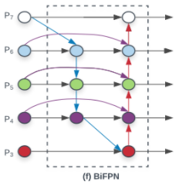
02 Recursive Feature Pyramid
FPN가 등장하고 난 후…

Slide 9
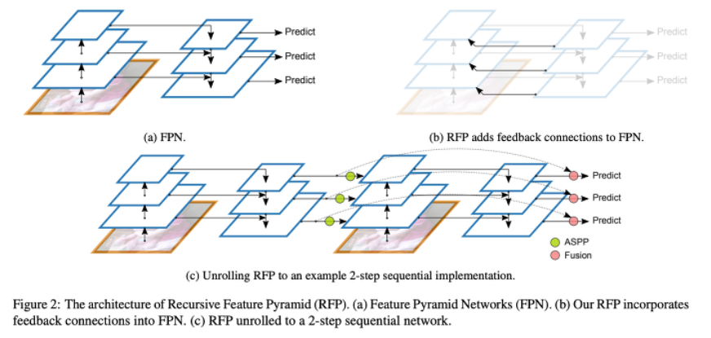
02 Recursive Feature Pyramid
ASPP - connecting module
Fusion - output update

Slide 10
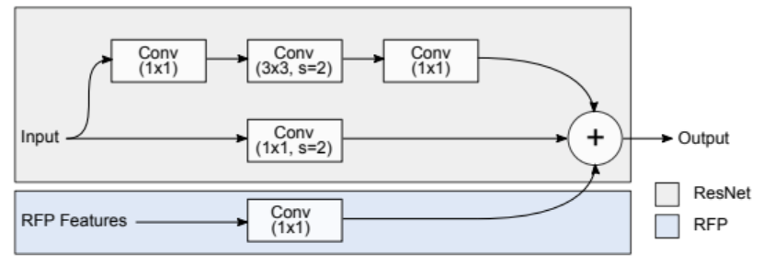
02 Recursive Feature Pyramid
ASPP 구조

Slide 11
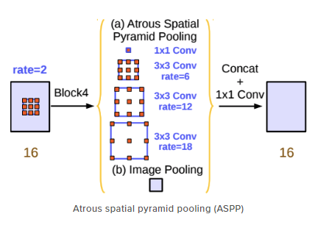
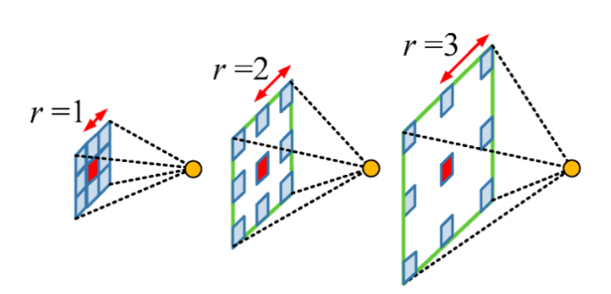
02 Recursive Feature Pyramid
Atrous Convolution
Spatial Pyramid Pooling
receptive field ↑
semantic segmentation performance ↑

Slide 12
Switchable Atrous Convolution

Slide 13
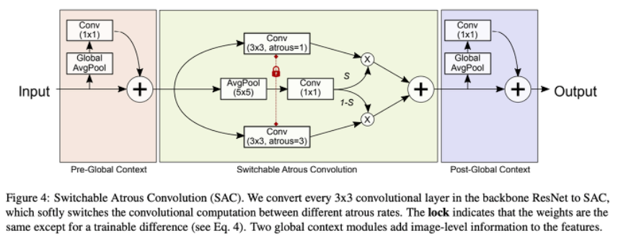
03 Switchable Atrous Convolution
2 Global Context + SAC

Slide 14
Experiment

Slide 15
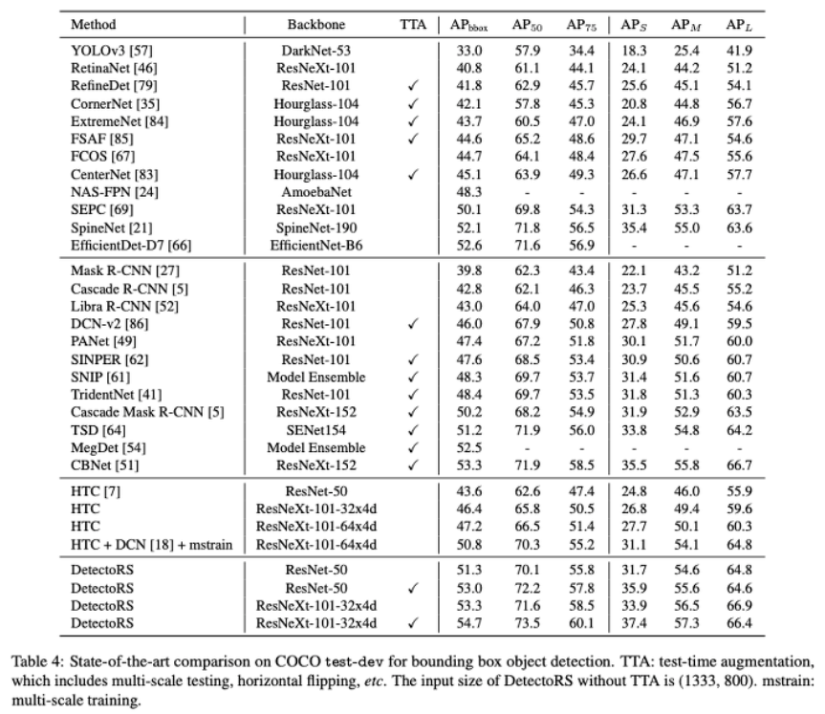
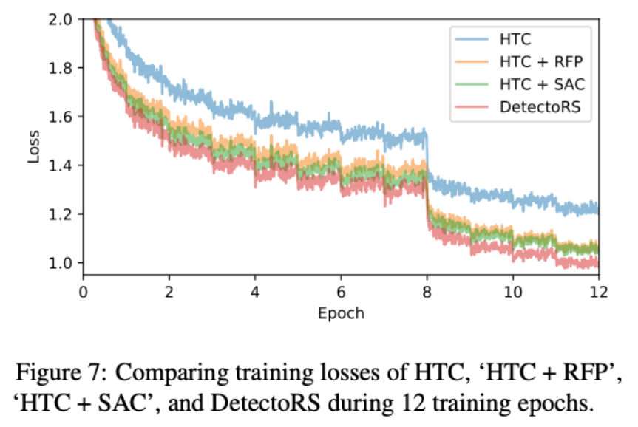
04 Experiment

Slide 16
감사합니다

